Slide 1
CBOW + NN
Bayesian Buccanneers Ben, Umut, Tomas, AJ

Slide 2
Vibe Coding to Vibe Coping
Using Natural Language to cope.

Slide 3
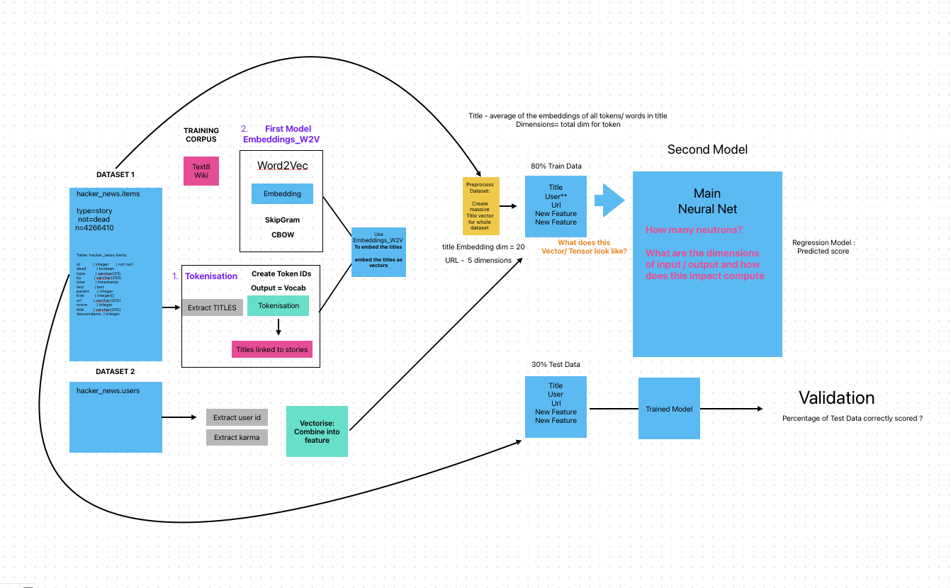
Schema for Word2Vec, CBOW and NN

Slide 4
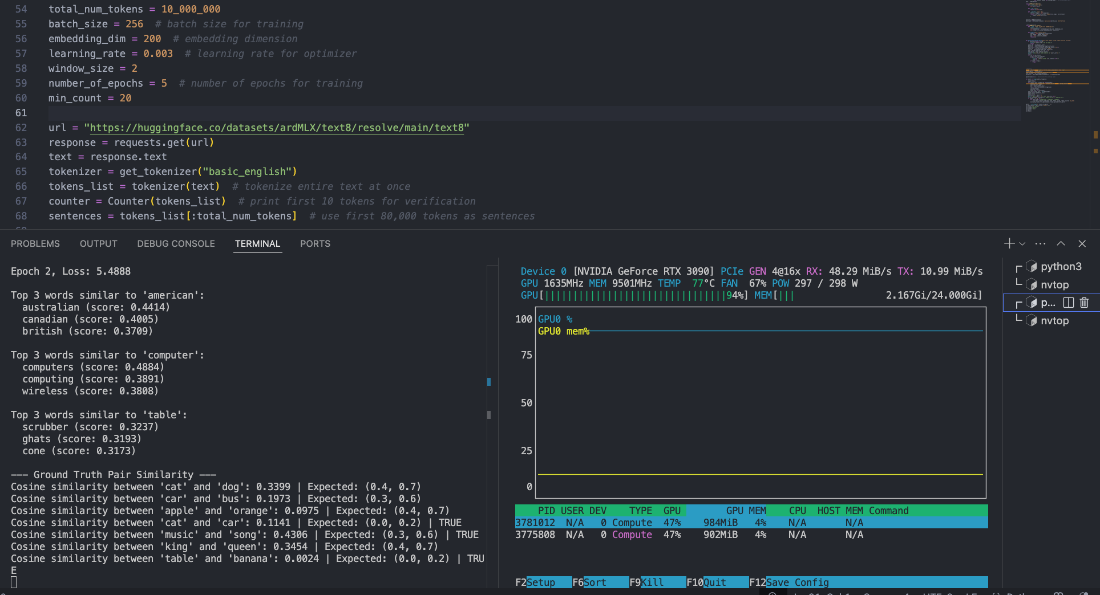
Training CBOW via GPU

Slide 5
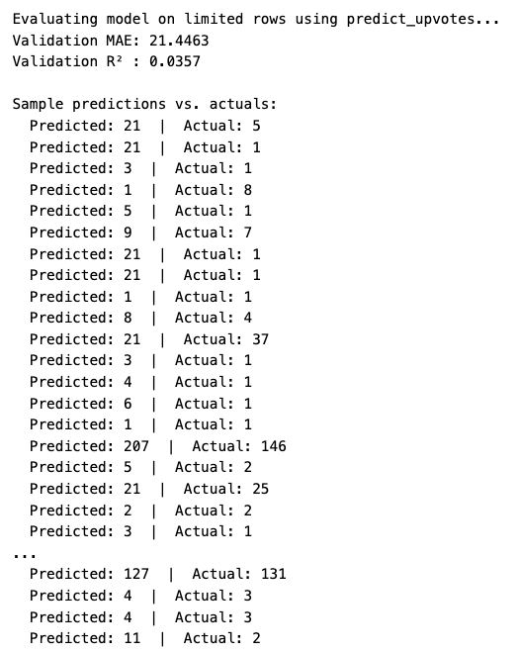
Evaluating the results
# Compute metrics
mae = mean_absolute_error(all_targets, all_preds) r2 = r2_score(all_targets, all_preds)
print(f"Validation MAE: {mae:.4f}") print(f"Validation R² : {r2:.4f}")
for p, t in list(zip(all_preds, all_targets))[:20]: print(f" Predicted: {p} | Actual: {t}")

Slide 6
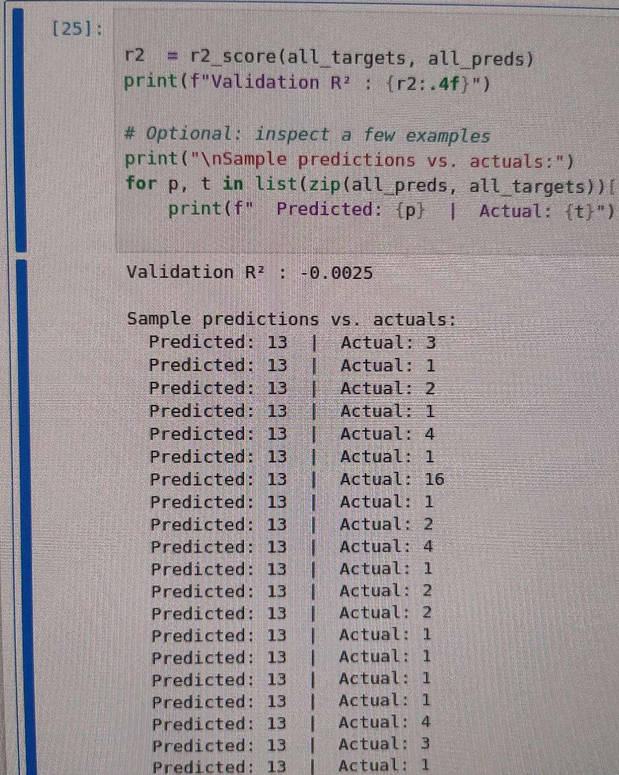
ML Luck 🍀
When we thought predictions can’t get worse...

Slide 7
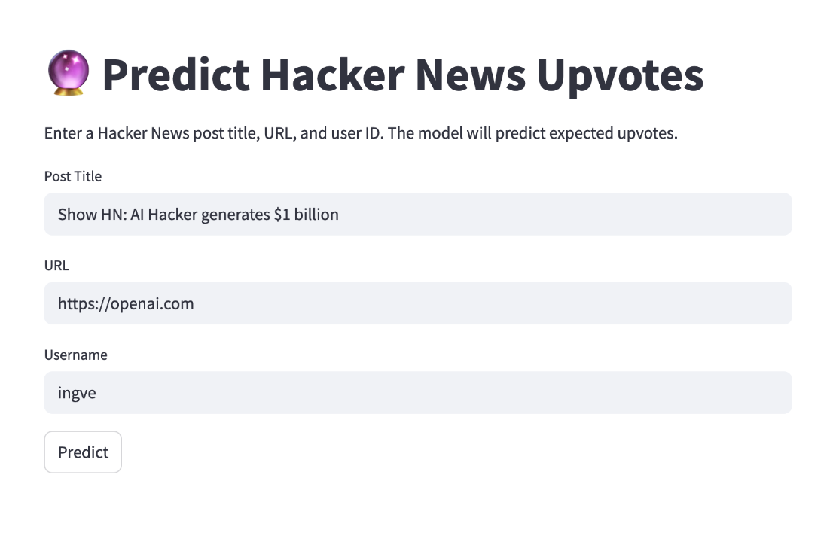
Streamlit UI
New Venv Requirements.txt Upload the .py code Upload the embeddings Run...

Slide 8
Learning Points
1. Aj: Utilising SQL queries to speed up data parsing - Setting up evaluation/validation as early as possible
2. Tomas: Training monitoring + understanding, then scaling up
3. Umut: Different CBOW embeddings, Feature engineering. Keeping it simple works best. Learning Rate makes big difference... Getting a simple model to work is and then tweaking is the best way to progress...
4. Ben: sshing into remote GPU, playing with the parameters in word2vec & understanding relationships.

Slide 9
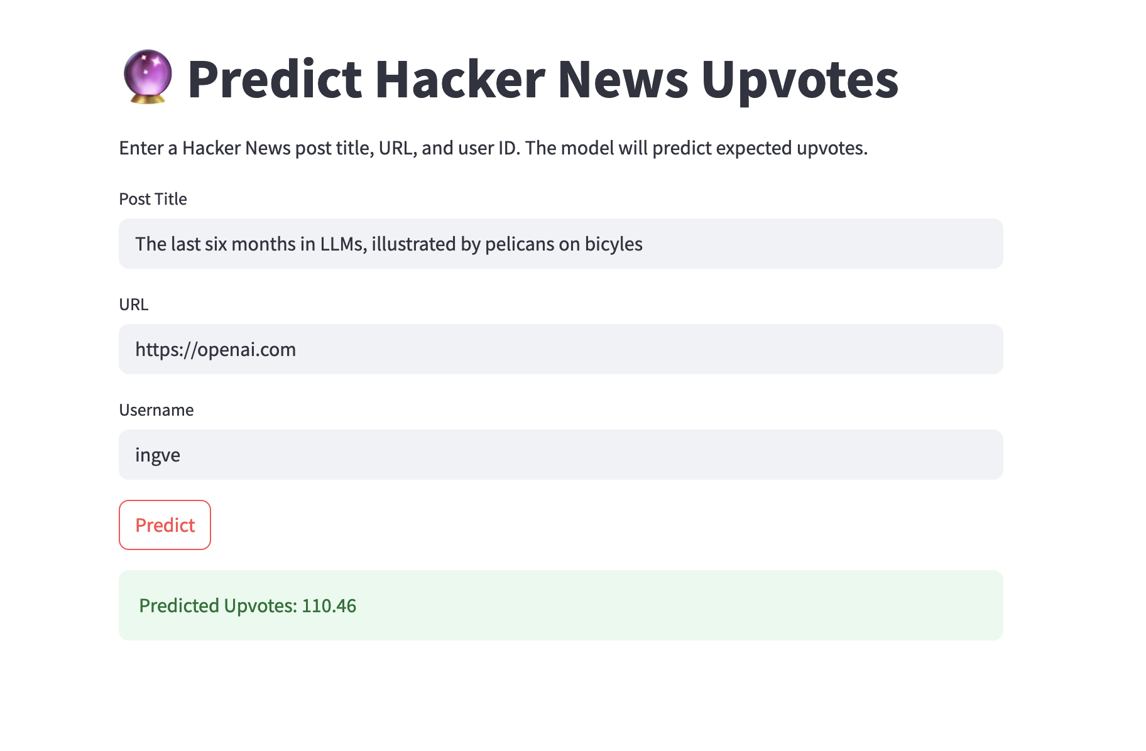
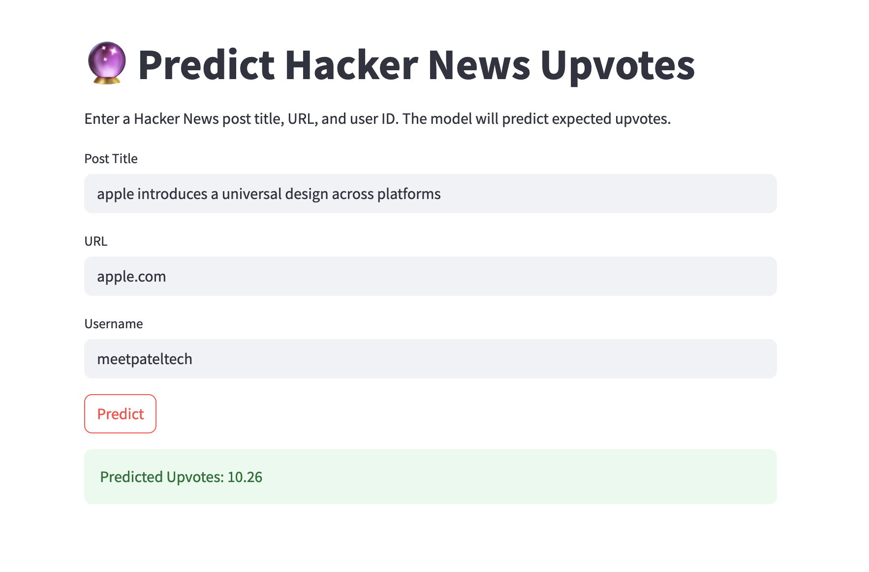
Real Upvotes: 942
Real Upvotes: 727

Slide 10
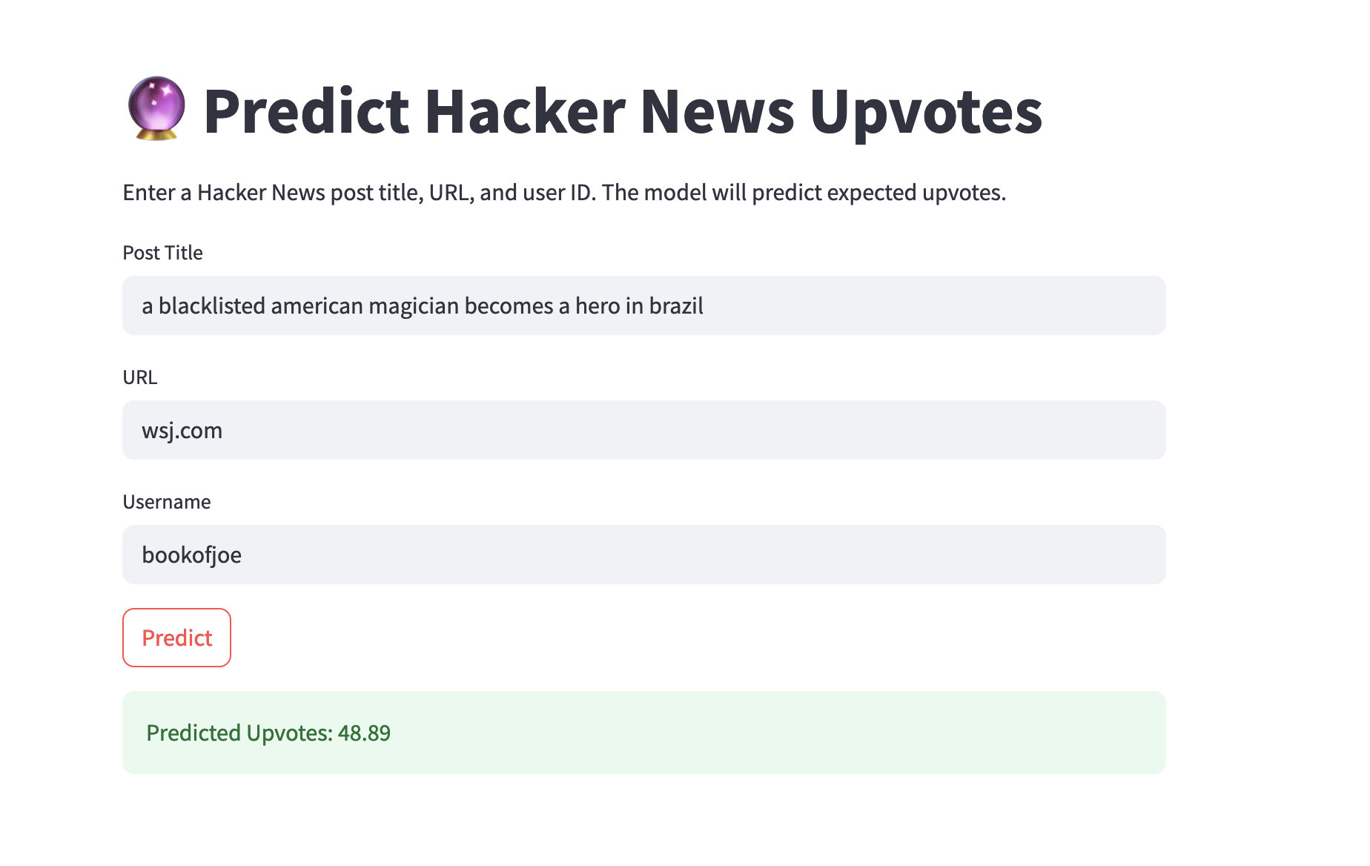
Real Upvotes: 118

Slide 11
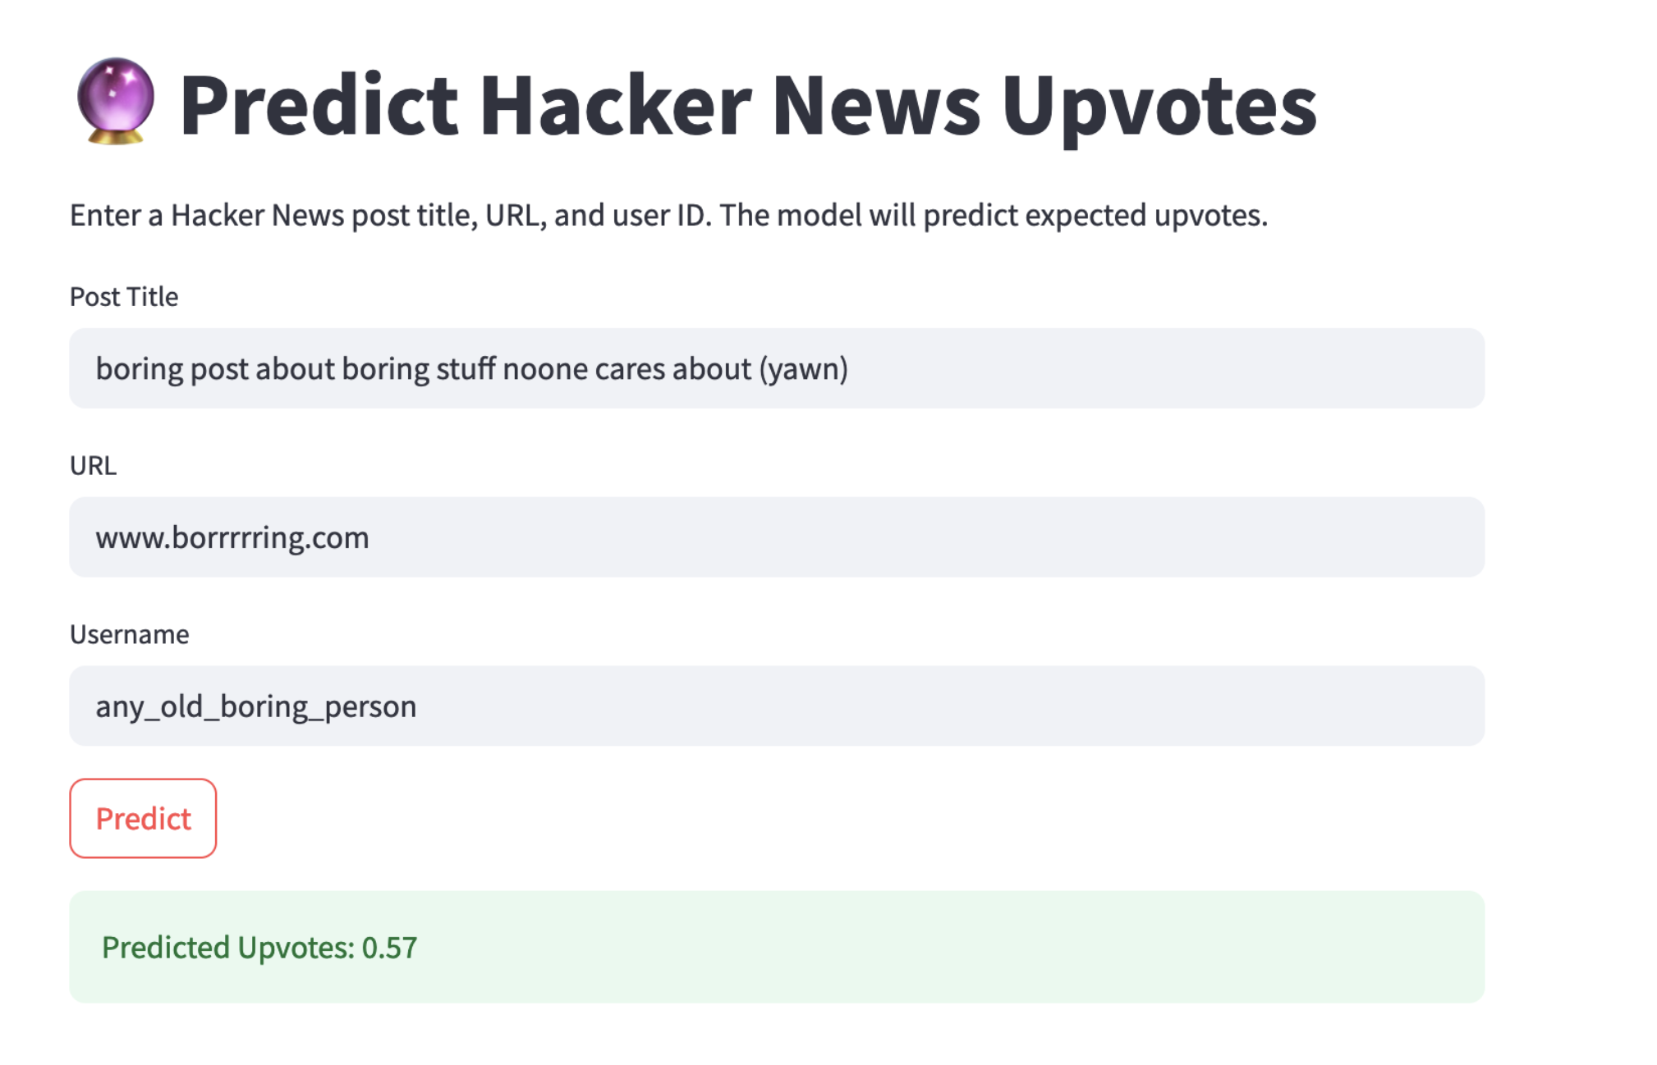
Real Upvotes: 0 (We guess!)

